Slide 1
Fluid Mechanics II

Slide 2
Recall
Continuum hypothesis: Material and transport properties
Newtonian fluids
Relation Stress vs Rate of Strain; pressure and
        density variations
Reynolds number, Navier-Stokes eqns-additional
  body forces, interfacial tension: statics, interface
  Deformation, gradients

Slide 3
From atoms to atmospheres
Mechanics in the physical sciences
  Classical mechanics
    particles and rigid body dynamics
  Celestial mechanics
    motion of stars, planets, comets,…
  Quantum mechanics
    atoms and clusters of atoms
  Statistical mechanics
    properties of large numbers

Slide 4
From atoms to atmospheres
Continuum mechanics(materials viewed as continua)
  Electrodynamics
  Thermodynamics
  Solid mechanics
  Fluid mechanics

Slide 5
View of the world by Fluid Dynamists

Slide 6

Fluid Motion Occurs In Many Forms Around Us
Water Waves
Short Waves
Big Waves
Ship Waves

Slide 7
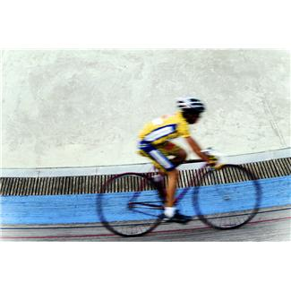


Fluid Motion Occurs In Many Forms Around Us
Formula one
Bicycling
Airplanes

Slide 8
Fluid Motion Occurs In Many Forms Around Us
Large and Small
Micro-Organisms
flagella- cilia
Sperm

Slide 9
Fluid Motion Occurs In Many Forms Around Us
Running of water
Rowing
Speed vs number of rowers
Jesus Lizard

Slide 10
Fluid Motion Occurs In Many Forms Around Us
Small Fluid Drops (Surface tension is important)

Slide 11
Fluid Motion Occurs In Many Forms Around Us
A dolphin Blowing a toroidal Bubble

Slide 12
Elementary Concepts
1. Continuum Hypothesis

Slide 13
Elementary Concepts
2. Molecular Dynamics
Coalescence of two L-J liquid flow in a Couette flow. Static atomic configuration
of the drop and walls after equilibrium at time 20ƭ (a) 75, 96, 98, 100, 102, 140ƭ8 (b-g)

Slide 14
Elementary Concepts
3. Thin Films
Examples:
Thin-film photovoltaic cells
Thin-film batteries

Slide 15
Elementary Concepts
4. Viscosity and Newtonian Fluids

Slide 16
Elementary Concepts
5. On to equations of motions

Slide 17
Elementary Concepts
5. On to equations of motions (cont)

Slide 18
Elementary Concepts
5. On to equations of motions (cont)

Slide 19
Elementary Concepts
5. On to equations of motions (cont)
Magnetic: ferrofluid is a liquid which becomes strongly magnetized in the presence of a magnetic field. A liquid magnet or ferrofluid is a colloidal mixture of magnetic particles (~10 nm in diameter)
Electric: electric fields and dielectric materials, electrokinetic flows, electrophoresis.
Notes:
Electrokinetic flow covers in principle the transport of liquids (electroosmosis) and samples (electrophoresis) in response to an electric field. Both motions are associated with the electric double layer that is formed spontaneously at the solid–liquid interface in which there is a net charge density.

Slide 20
Elementary Concepts
6. Reynolds Number
Newton´s Second Law

Slide 21
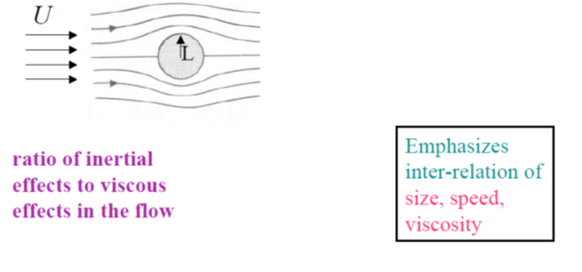

Elementary Concepts
6. Reynolds Number
$$R_{e}=\frac{ρUL }{μ}$$

Slide 22
Elementary Concepts
6. Interfacial tension (Force/Length or energy/area)

Slide 23
Elementary Concepts
6. Interfacial tension (Force/Length or energy/area)

Slide 24
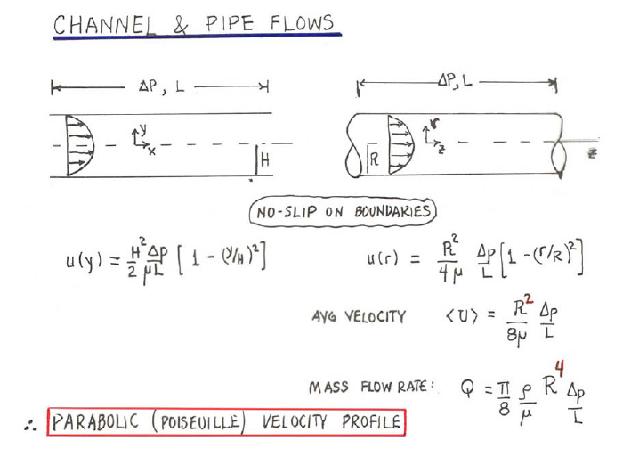
Prototypical Flows
1. Steady Pressure-Driven flows

Slide 25
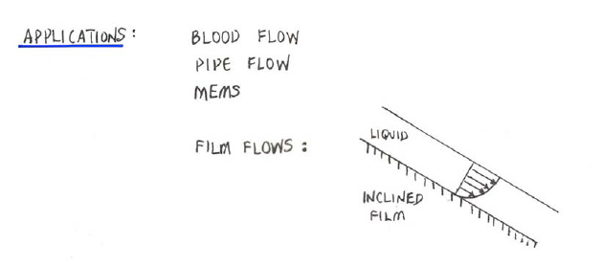
Prototypical Flows
1. Steady Pressure-Driven flows (Cont.)

Slide 26
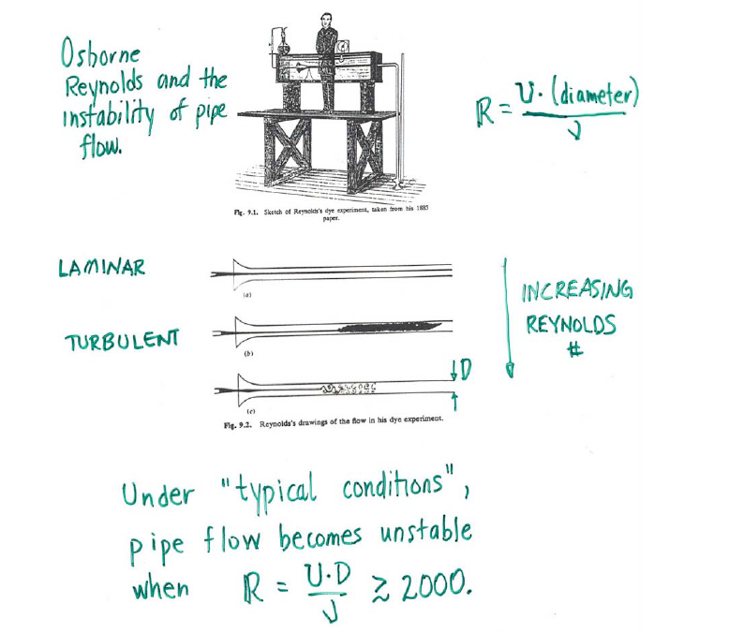
Prototypical Flows
2. Condition Flows

